Slide 1

"Starting a Career in Data Science"

Slide 2
Agenda
What is Data Science
Data Science Life Cycle
Skills Required for Data Science
Applications of Data Science
Tools of Data Science

Slide 3
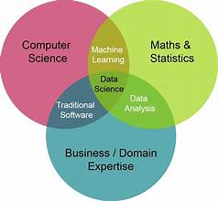
What is Data Science
The process of collecting, cleaning, analyzing, and interpreting data to uncover valuable insights and solve problems.
They use math, statistics, and computer skills to make sense of the data, helping businesses and organizations make better decisions.

Slide 4
Core Components of Data Science
Data Collection: Gathering relevant information.
Data Cleaning: Ensuring accuracy and preparing data for analysis.
Data Analysis: Using statistical methods and algorithms to discover patterns.
Data Interpretation: Translating findings into actionable insights.

Slide 5
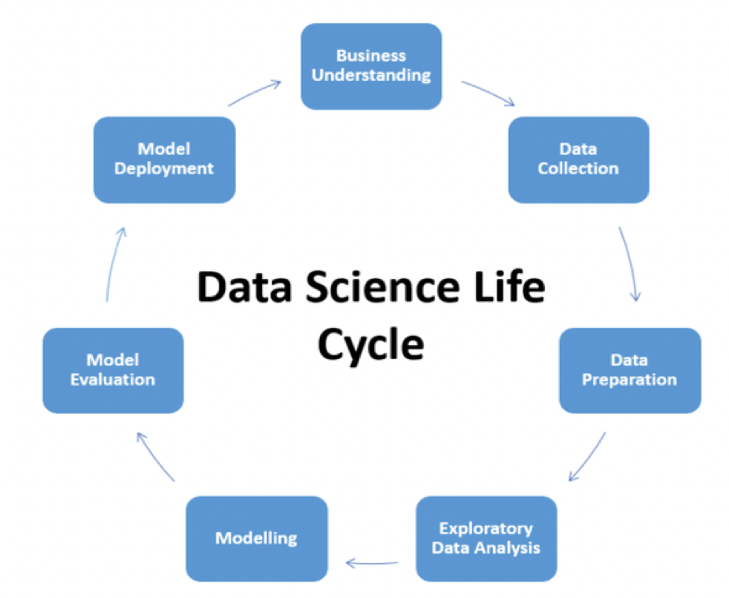
Data Science Life Cycle
The data science life cycle refers to the series of steps or stages involved in a typical data science project.

Slide 6
Skills Required for Data Science
Programming Skills:
Python or R: Proficiency in at least one programming language, with Python being widely used in the data science community.
Statistical Knowledge:
Understanding of statistical concepts and techniques for data analysis.
Data Manipulation and Analysis:
Pandas, NumPy: Tools for data manipulation and analysis in Python.
SQL: Proficiency in querying databases for data extraction.

Slide 7
Data Visualization:
Matplotlib, Seaborn, Plotly: Libraries for creating visualizations in Python.
Tableau, Power BI: Visualization tools for creating interactive dashboards.
Machine Learning:
Scikit-Learn, TensorFlow, PyTorch: Libraries for machine learning algorithms and models.
Understanding of various machine learning algorithms and techniques.
Neural Network:
Familiarity with Deep Leaning and Natural Language Processing

Slide 8
Domain Knowledge:
Understanding the specific industry or domain you are working in enhances your ability to interpret and solve problems effectively.
Communication Skills:
The ability to communicate complex technical findings to both technical and non-technical stakeholders.
Problem-Solving Skills:
A strong analytical mindset and the ability to approach problems systematically.
Critical Thinking:
The capability to assess situations, identify potential pitfalls, and make informed decisions.

Slide 9
Applications Of Data Science
Healthcare
Finance
Marketing
E-commerce
Education
Social Media
Entertainment

Slide 10
Tools of Data Science
Data Collection and Storage:
SQL
NoSQL
Data Cleaning and Pre-processing:
Pandas
OpenRefine
Data Analysis and Visualization:
Jupyter Notebooks
Rstudio
Tableau, Power BI
Matplotlib, Seaborn, Plotly

Slide 11
Machine Learning:
Scikit-Learn
TensorFlow
PyTorch
Cloud Platforms:
Amazon Web Services (AWS)
Microsoft Azure
Google Cloud Platform (GCP)

